Slide 1
Networking Fundamental
Preseented By : Tanaya Lotan Patil

Slide 2
What is Networking
Networking is the process of connecting two or more devices so they can communicate, exchange data, and share resources.
Key Points
Devices such as computers, mobiles, servers, and printers can be connected through a network.
Communication happens using network protocols such as TCP/IP.
Networks can use wired connections like Ethernet or wireless connections like Wi-Fi.
Networking allows resources such as files, printers, applications, and Internet connections to be shared.
Simple Example
Laptop → Wi-Fi Router → Internet → Web Server
When we open a website on our laptop, networking allows our device to communicate with the web server and receive the requested data.
Types of Networks
LAN – Local Area Network
WAN – Wide Area Network
MAN – Metropolitan Area Network

Slide 3
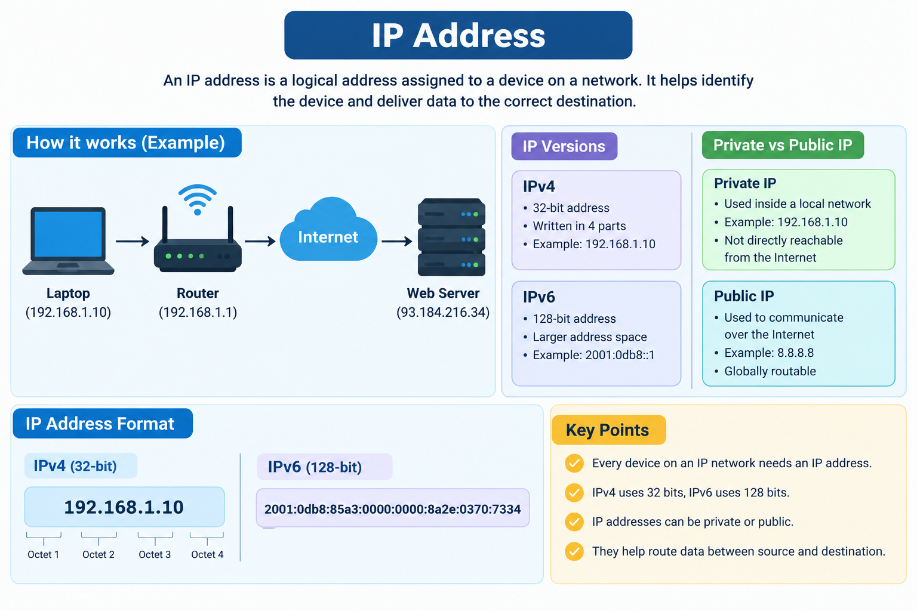
IP Address
An IP (Internet Protocol) address is a logical address assigned to a device on a network. It helps identify the device and deliver data to the correct destination.
Key Points
Every device communicating on an IP network needs an IP address.
IPv4 addresses are 32-bit and written in four parts.
Example: 192.168.1.10
IPv6 addresses are 128-bit and were introduced to provide a much larger address space.
IP addresses can be private or public.

Slide 4
Subnetting
Subnetting is the process of dividing a large network into smaller networks called subnets.
Key Points
A subnet is a smaller section of a larger network.
It uses a subnet mask to define the network and host portions.
It helps organize devices into different network sections.
It improves security, performance, and efficient IP address usage.
Simple Example
Suppose we have:
Network: 192.168.1.0/24
We can divide it into smaller networks for different departments:
Sales: 192.168.1.0/26
HR: 192.168.1.64/26
IT: 192.168.1.128/26
Management: 192.168.1.192/26

Slide 5
DNS – Domain Name System
DNS (Domain Name System) is a system that converts a domain name into an IP address.
Key Points
Humans remember names like google.com more easily than IP addresses.
Computers communicate using IP addresses.
DNS finds the IP address associated with a domain name.
DNS works like the phonebook of the Internet.
Simple Example
When you type:
www.google.com
↓
DNS Server
↓
IP Address
↓
Google Web Server
The browser then uses that IP address to connect to the server.

Slide 6
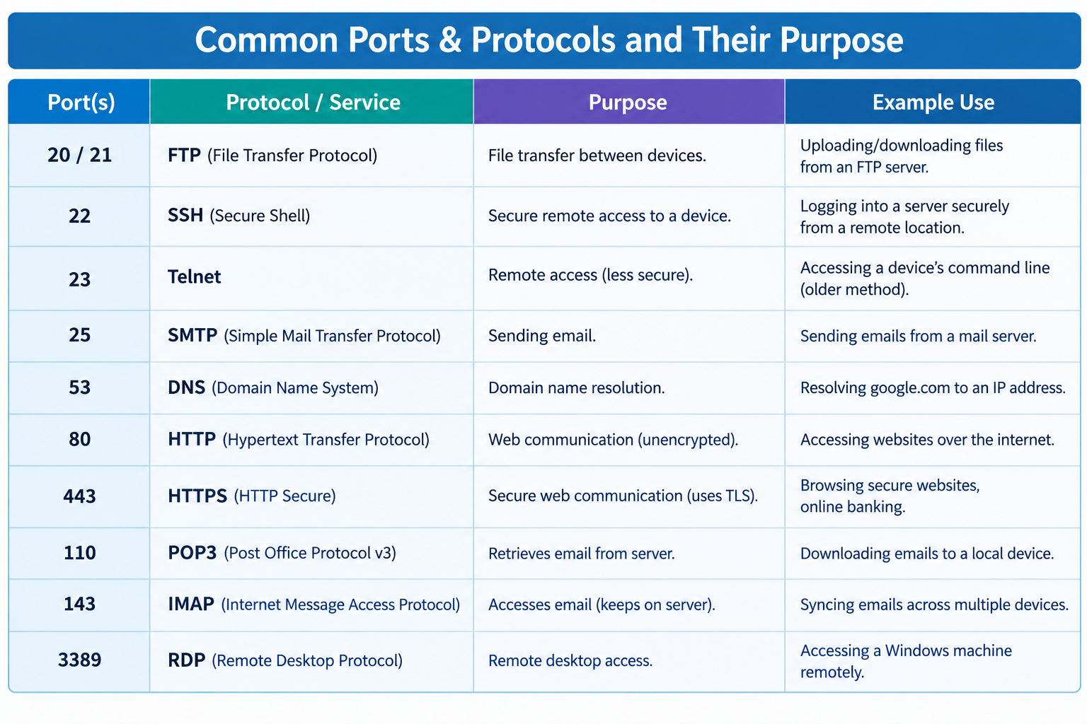
Ports & Protocols
What is a Port?
A port is a logical communication endpoint used to identify a specific service or application running on a device.
For example, a server can run web services, SSH, and DNS at the same time, using different ports.
What is a Protocol?
A protocol is a set of rules that defines how devices communicate and exchange data.

Slide 7
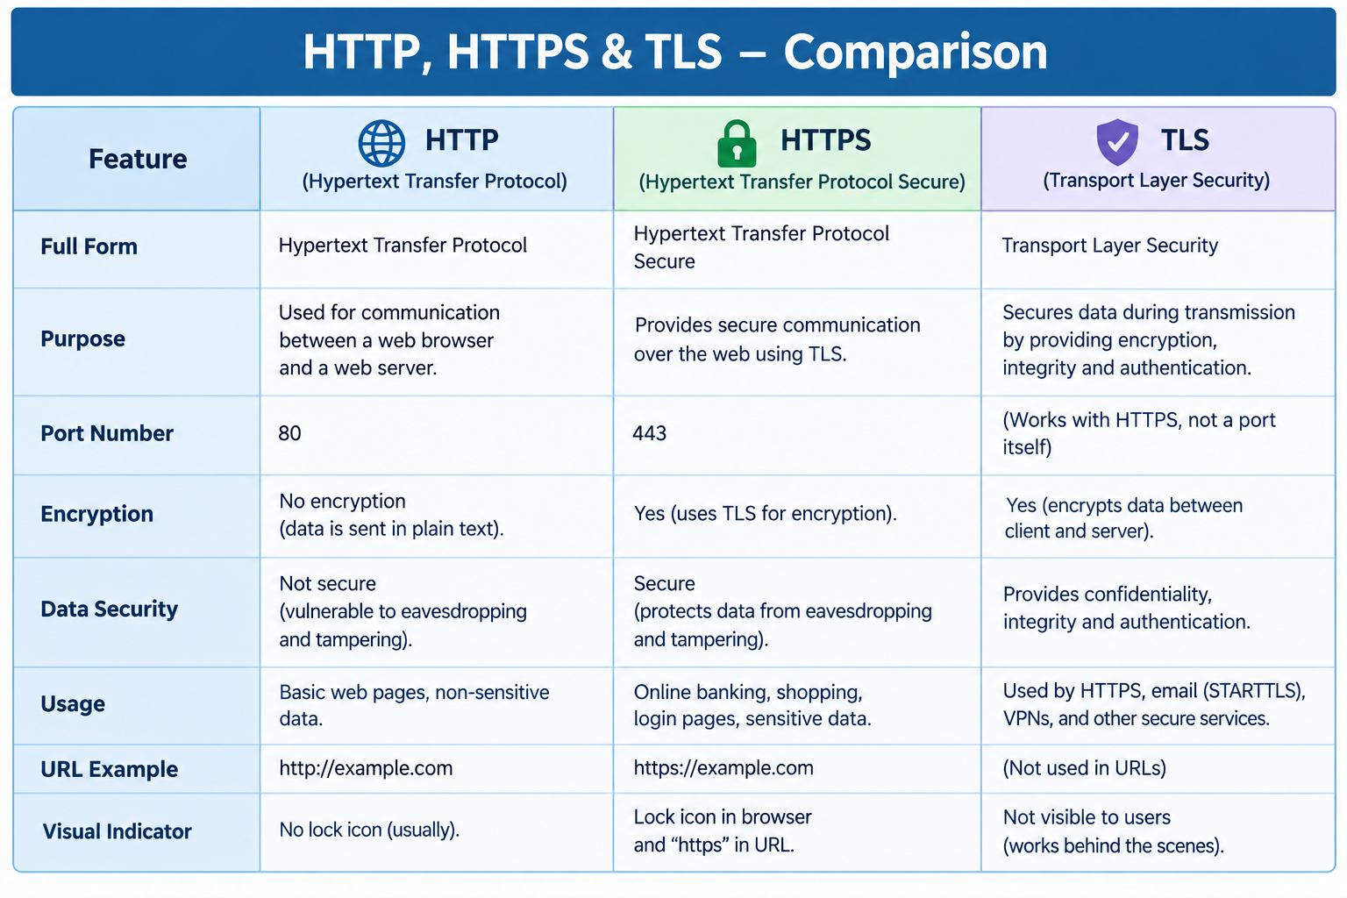
HTTP, HTTPS & TLS

Slide 8
Active Directory, LDAP & OSI Model
Easy Example
User Login → Active Directory → LDAP → Network Communication → OSI Layers
For example:
Employee
↓
Login to company laptop
↓
Active Directory checks identity & permissions
↓
LDAP can be used to query directory information
↓
Network protocols carry the communication through the OSI layers
One-line explanation
“Active Directory manages users and resources, LDAP provides a standard way to access directory information, and the OSI model helps us understand how the network communication supporting these services takes place.”

Slide 9
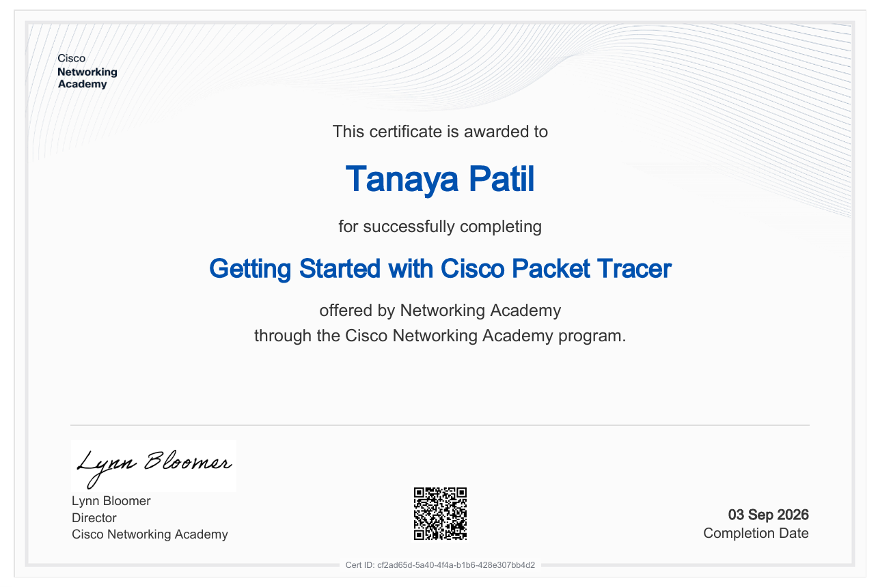
Certification – Cisco Packet Tracer
Along with the classroom lab, I also completed the Getting Started with Cisco Packet Tracer certification through Cisco Networking Academy. Packet Tracer helped me understand networking concepts practically by allowing me to work with simulated network devices and connections. This gave me a better understanding of how networks are designed and how different devices communicate

